Slide 1
Transport Layer

Slide 2
The transport layer is responsible for process-to-process delivery
the delivery of a packet, part of a message, from one process to another
It provides logical communication between app processes running on different
hosts
transport protocols run in end systems
send side: breaks app messages into segments, passes to network layer
rcv side: reassembles segments into messages, passes to app layer
more than one transport protocol available to apps
Internet: TCP and UDP

Slide 3
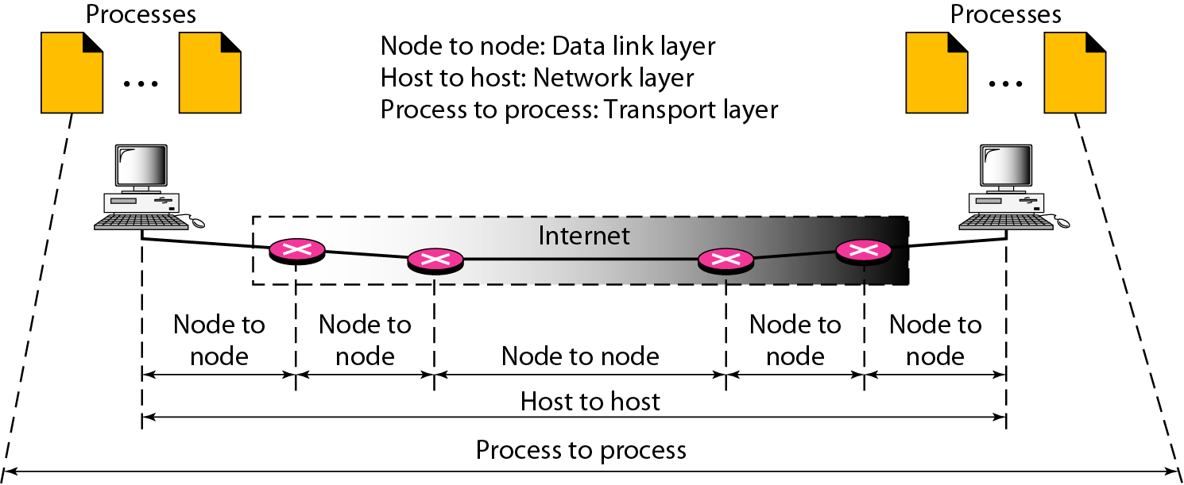
Types of data deliveries: Internet Stack

Slide 4
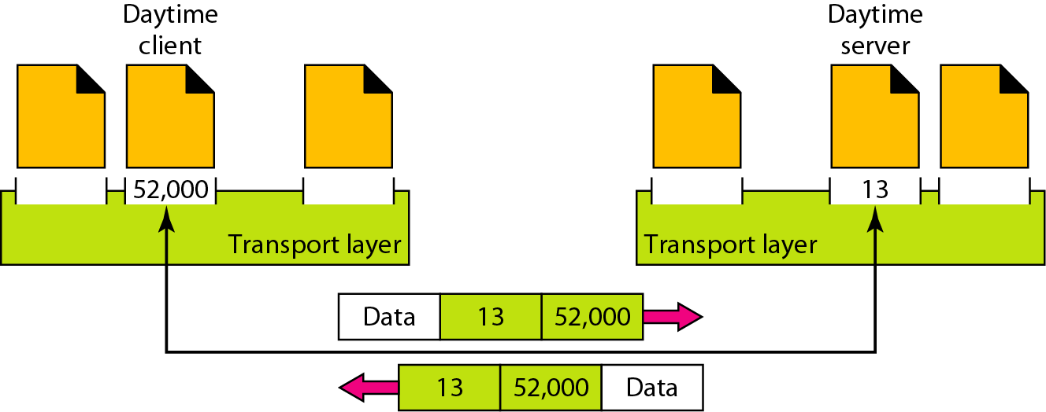
How it delivers messages to specific process
Using Port address (16 bit)
Ranges from 0 to 65,535

Slide 5
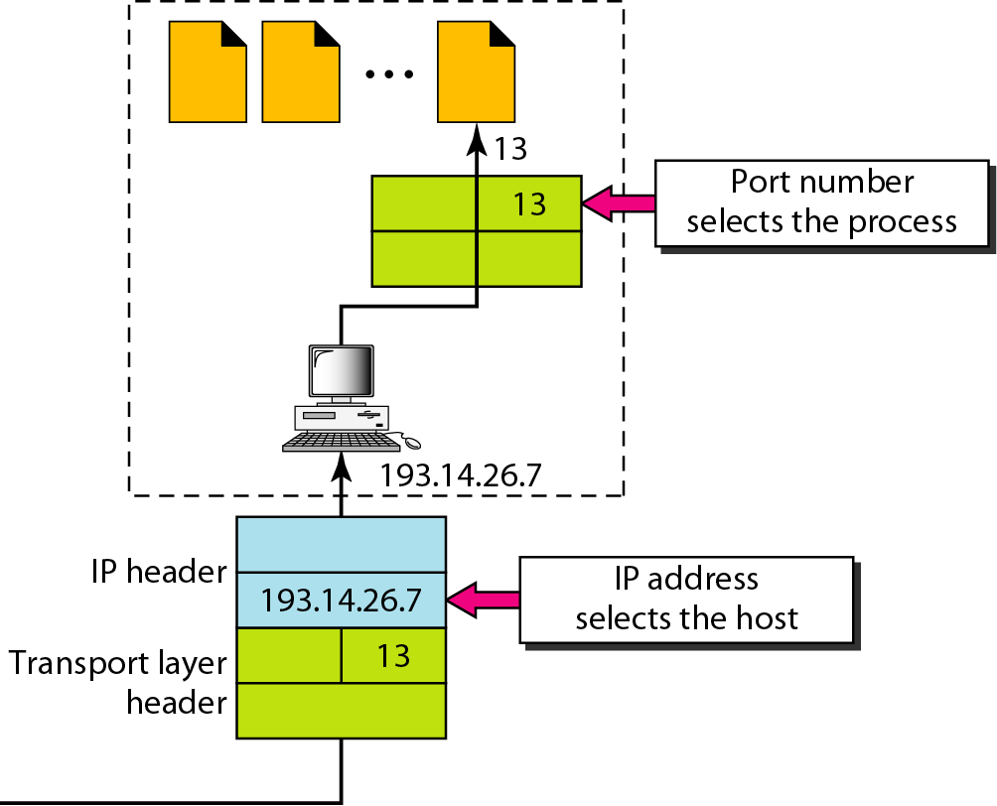
IP addresses v/s port numbers

Slide 6
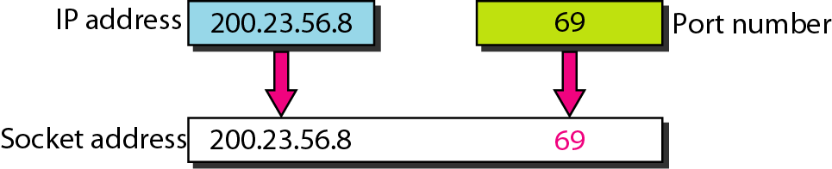
Socket address (IP address + Port Address)
What is the use of socket?
The socket mechanism provides a means of inter-process communication (IPC)
Socket is basically an API for enabling communication between two end points
A socket is one endpoint of a two way communication link between two
programs running on the network

Slide 7
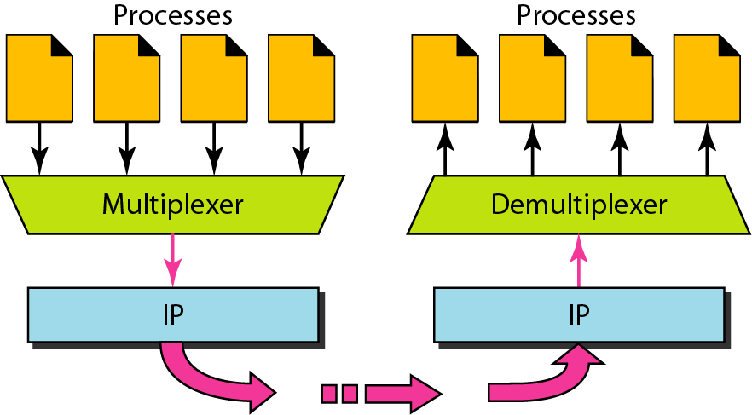
Multiplexing and De-multiplexing

Slide 8
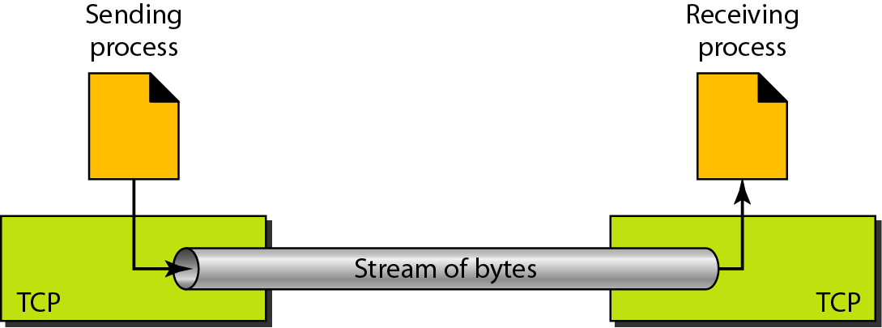
TCP (Transmission Control Protocol)
TCP is a connection-oriented protocol
It creates a virtual connection between two TCPs to send data
In addition, TCP uses flow and error control mechanisms at the transport level

Slide 9
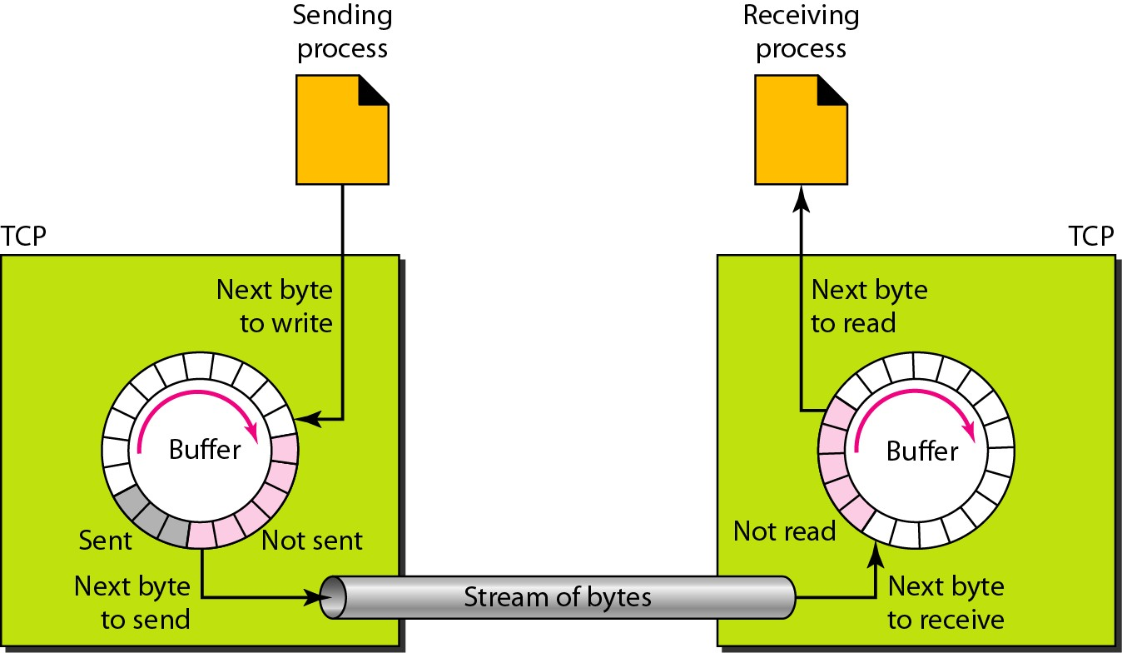
Sending and Receiving buffer

Slide 10
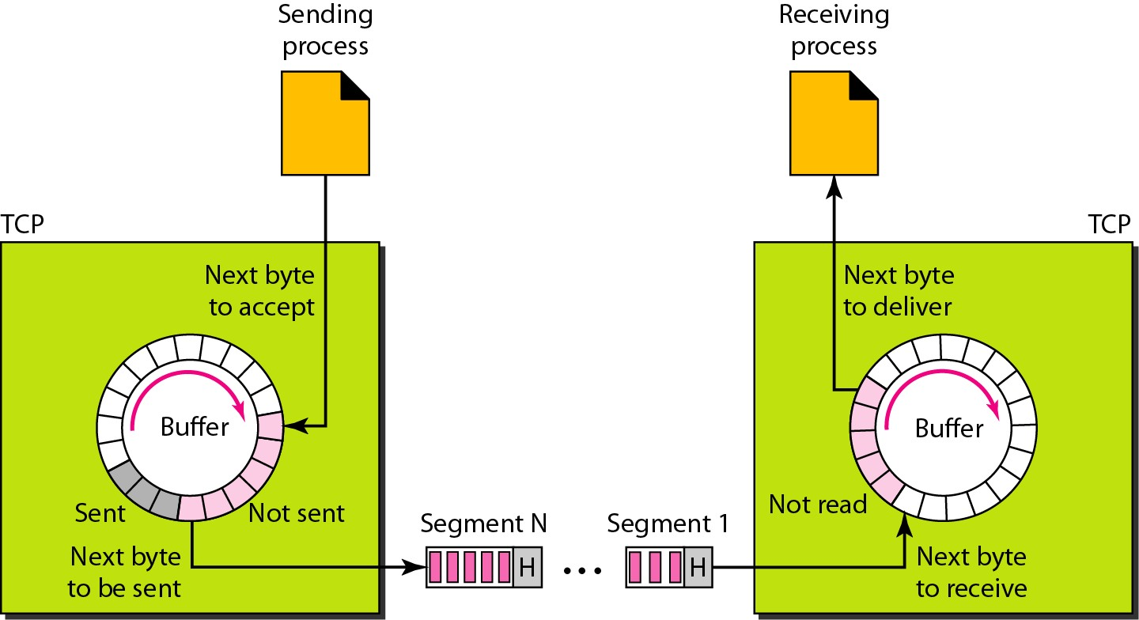
TCP segments
The bytes of data being transferred in each connection are numbered by TCP
The numbering starts with an arbitrarily generated number

Slide 11
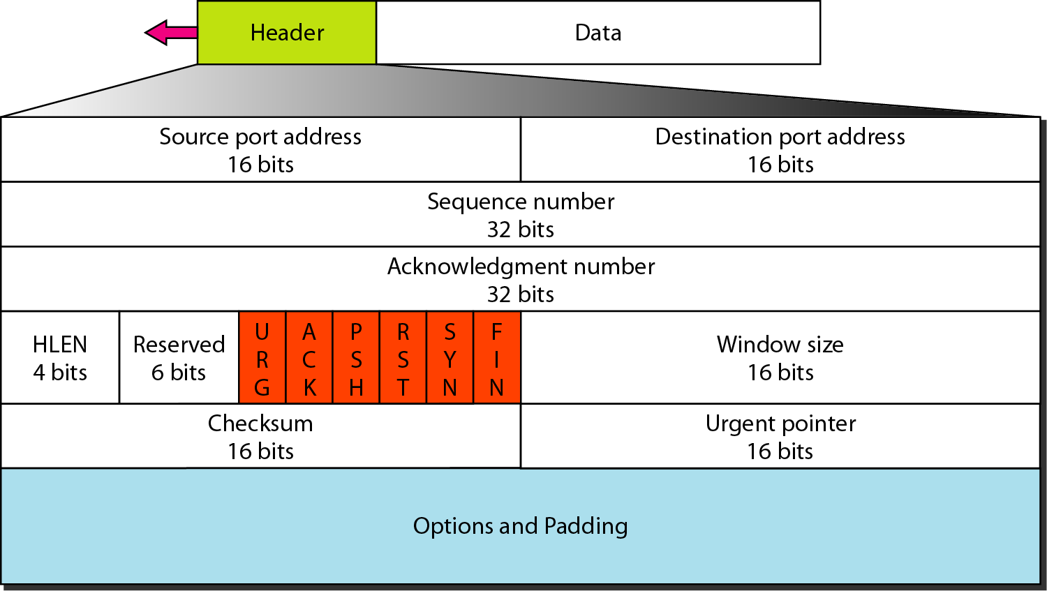
Segment
Before discussing TCP in more detail, let us discuss the TCP packets themselves. A packet in TCP is called a segment

Slide 12
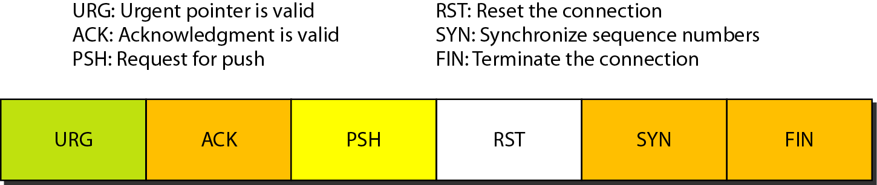
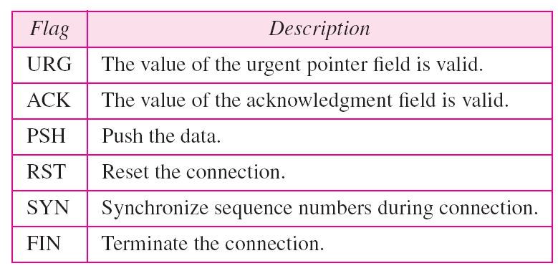
Description of flags in the control field
Control field

